Slide 1
OCRA Salesforce User Training
June 2020

Slide 2
Agenda
Signing into Salesforce
Home Tab
Salesforce Navigation
Clients Tab
Contacts Tab
Tasks
Calendar
Common Tools
Reports
Dashboards
Salesforce Mobile

Slide 3
Signing In

Slide 4
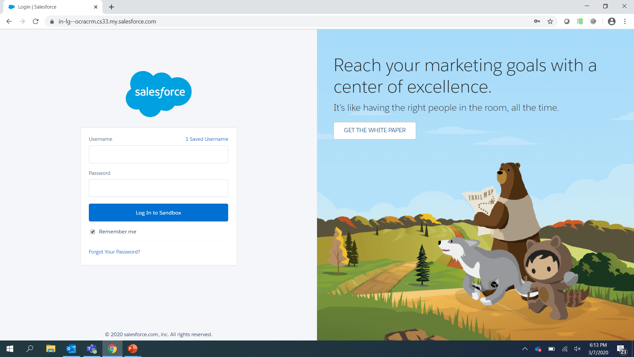
Salesforce URLs
Salesforce URL for Production
https://in-lg.my.salesforce.com/
Username is your email and password

Slide 5
Navigation
Salesforce is a web-based application that uses familiar ‘point and click’ navigation.

Slide 6
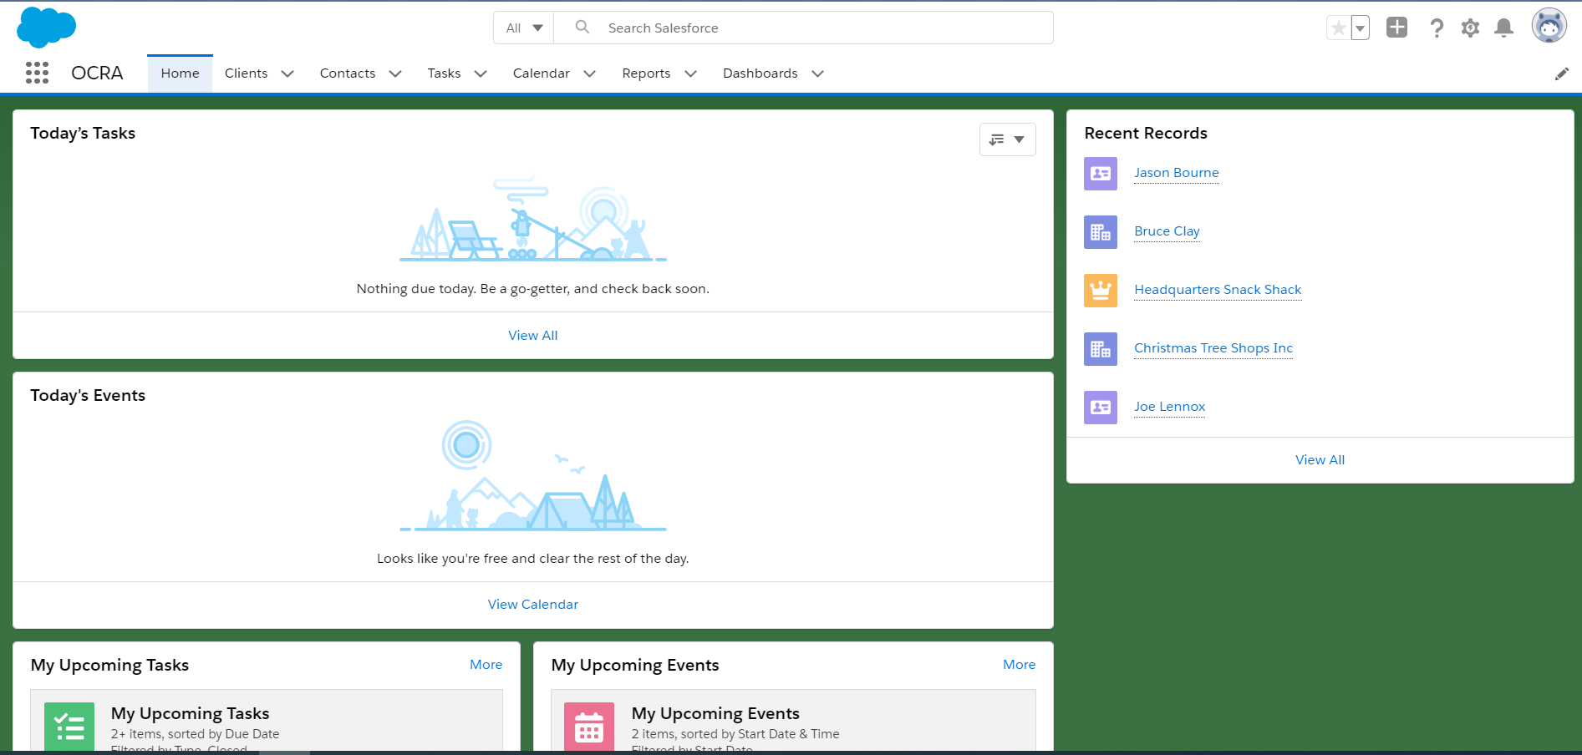
The navigation bar at the top of the page organizes most of the navigation controls that you will use.

Slide 7
Global Search Bar : key word searches the entirety of Salesforce to find matching records
App Launcher : Navigate to other apps you have access to
Object Tabs : Quickly navigate to the object you can read, create and edit
Notification Bell : Indicator when you are @mentioned
1
4
2
3

Slide 8
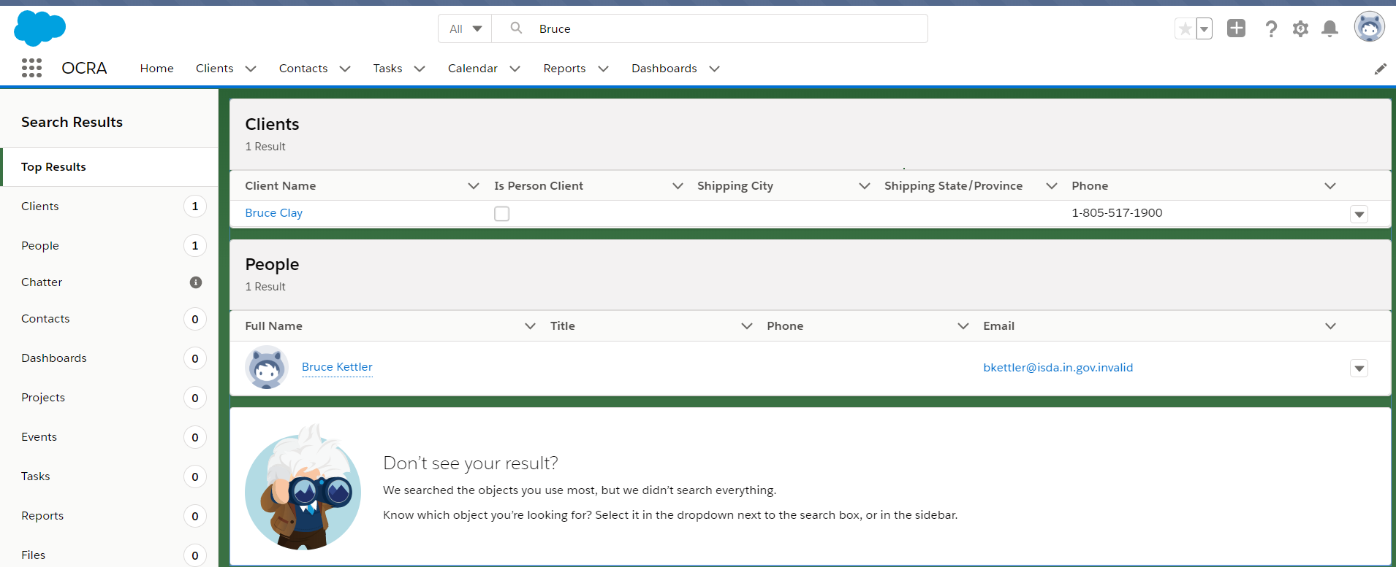
Global Search
The quickest and easiest way to locate data within Salesforce is through the Global Search.
The Global Search will search through all accessible data and provide a list of results, by data object. In the example below a search for Bruce returns 2 results. One for a Client and One for a Person.

Slide 9
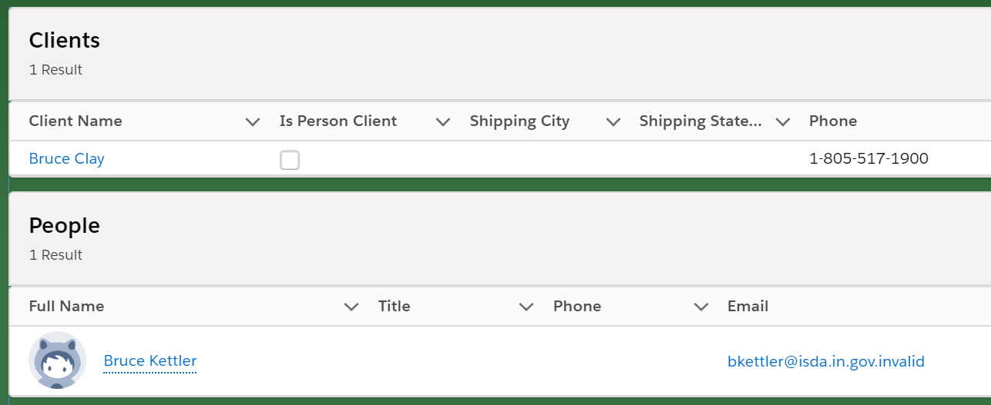
Record Hyperlinks
Whenever a field on a Salesforce page references another record, the field is displayed as a hyperlink and clicking the link navigates you to the related record detail page.

Slide 10
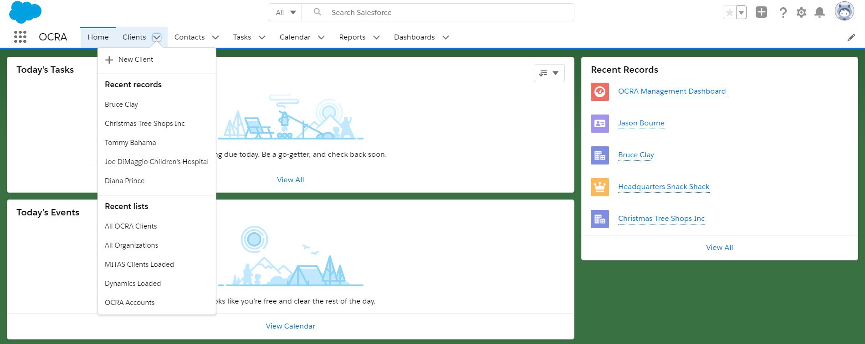
Navigation Tabs
You can use these tabs to navigate directly to a specific data group. Directly on the tab, you can use the drop-down caret to quickly add a new record or access recently-viewed records or list views.

Slide 11
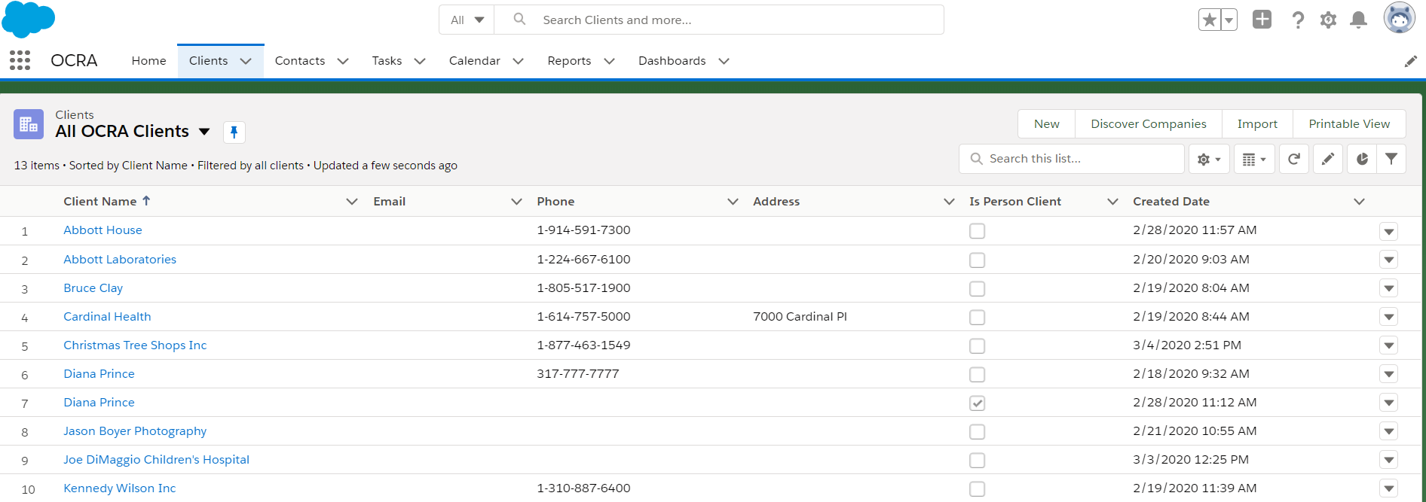
List Views
Navigating to a tab will present the List Views page. List Views are a very powerful way to filter and view data without requiring reports. By default, Salesforce will always display the Recently Viewed list view first. You can select additional list views by using the dropdown control by the List View Name and pinning your favorite.

Slide 12
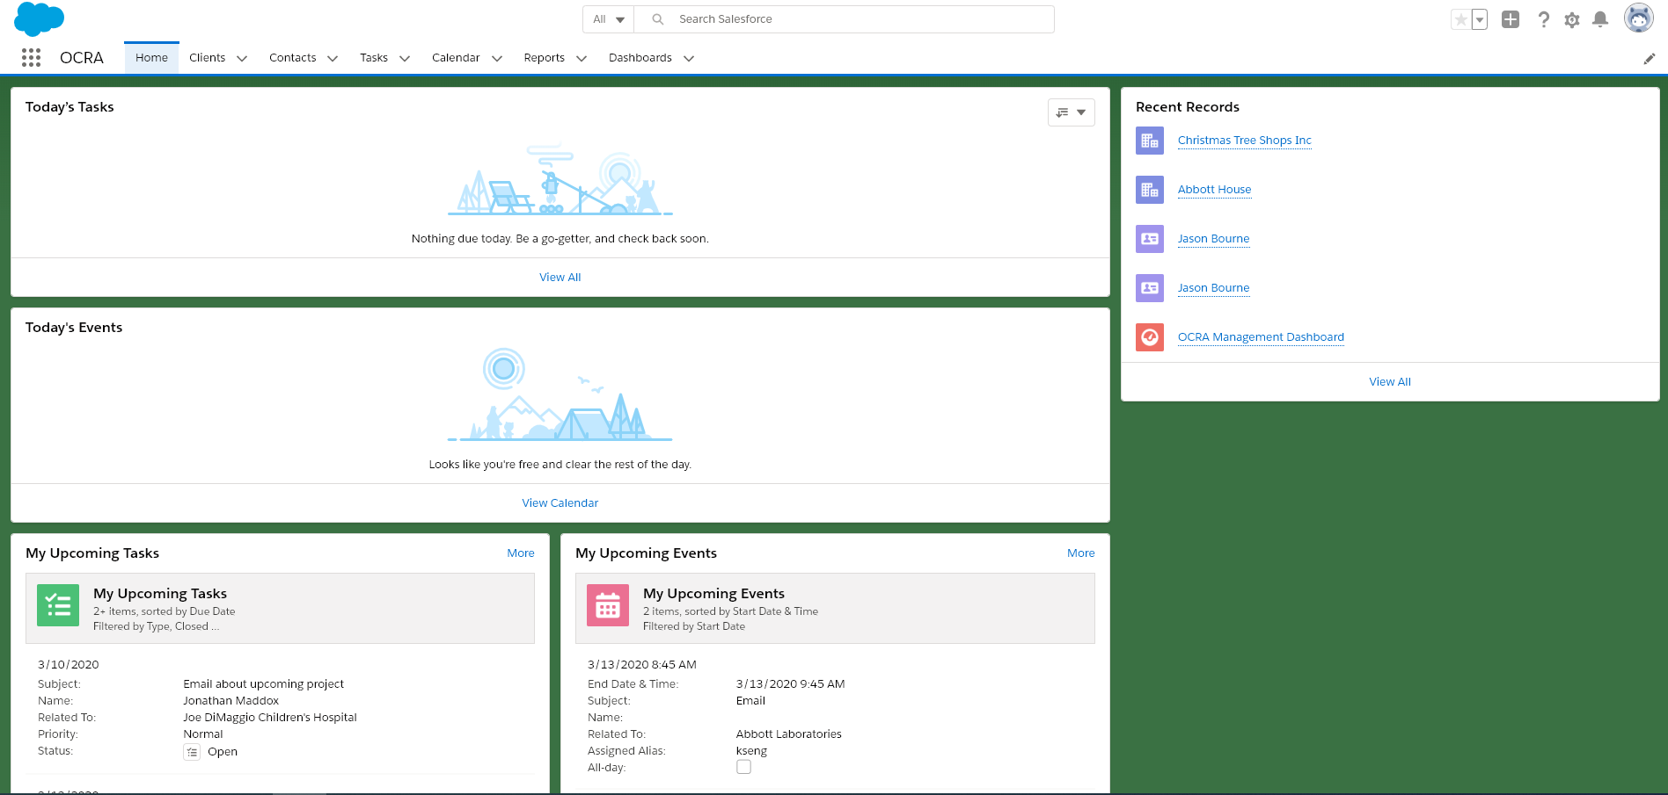
Home Tab

Slide 13
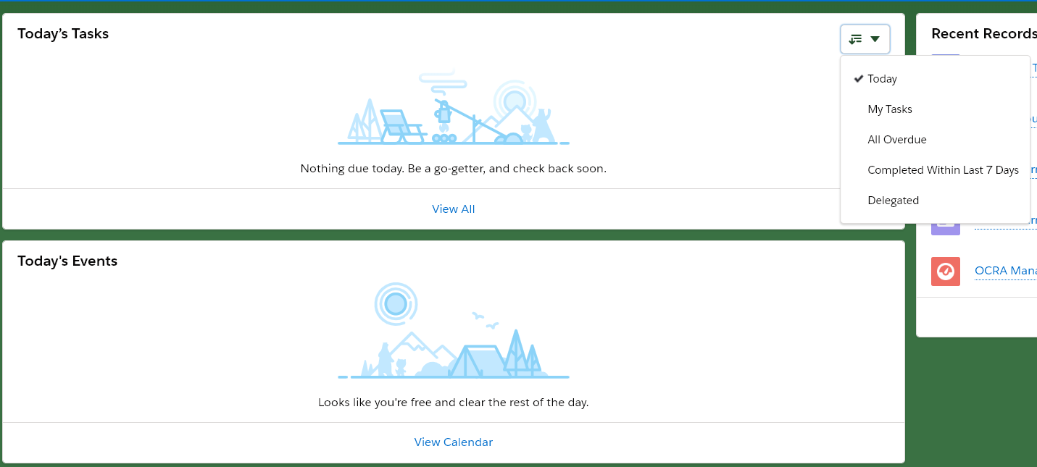
Home tab con’t
Use the drop down to
control the display for Tasks
Clicking on the hyperlink will navigate you to the receptive object

Slide 14
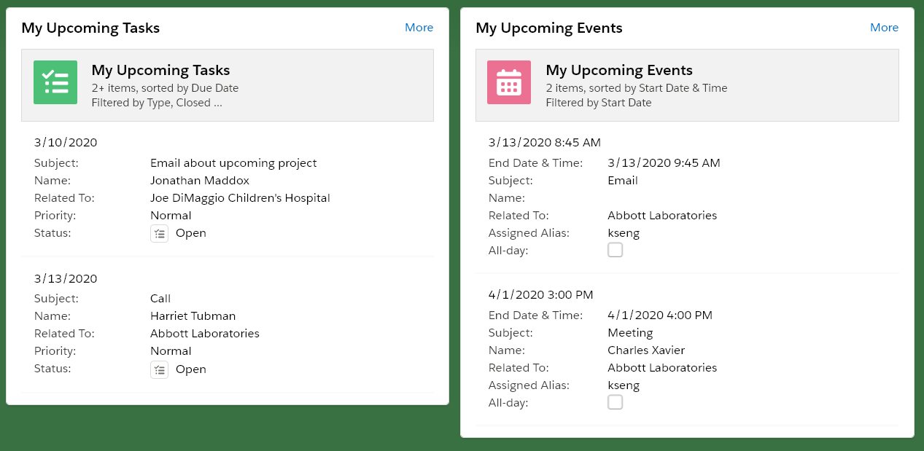
Home tab con’t
My Upcoming Tasks and My Upcoming Events are set to show the first 2 records based on date and time.
For visibility into additional records click on the hyperlink and you will be navigated to the respective object list view.

Slide 15
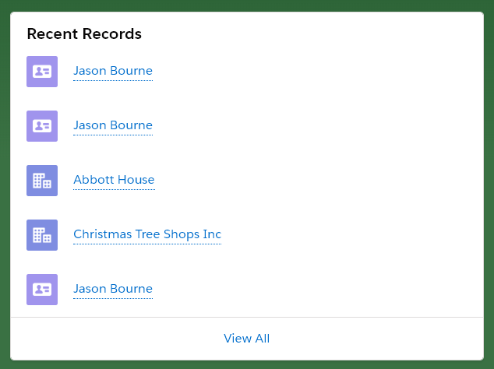
Home tab con’t
Recent Records will list the 5 most recent records you last viewed, created or edited. Clicking on the hyperlink will navigate you to a list of 20 recent records.

Slide 16
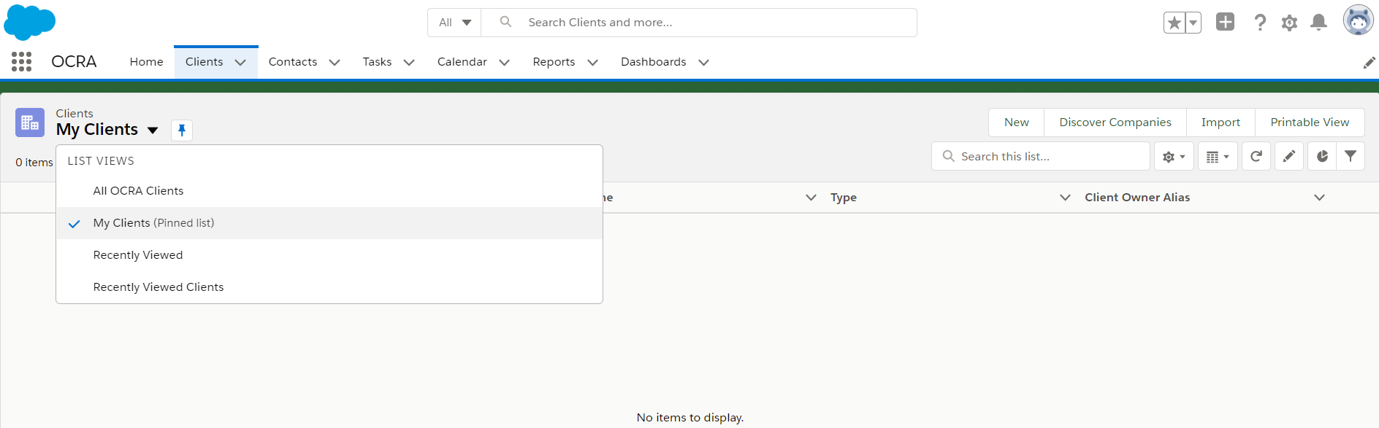
Client tab
My Clients list view is set to show only records owned by the running user. In this example, the running user has not created any Client records. They currently do not “own” any records.

Slide 17
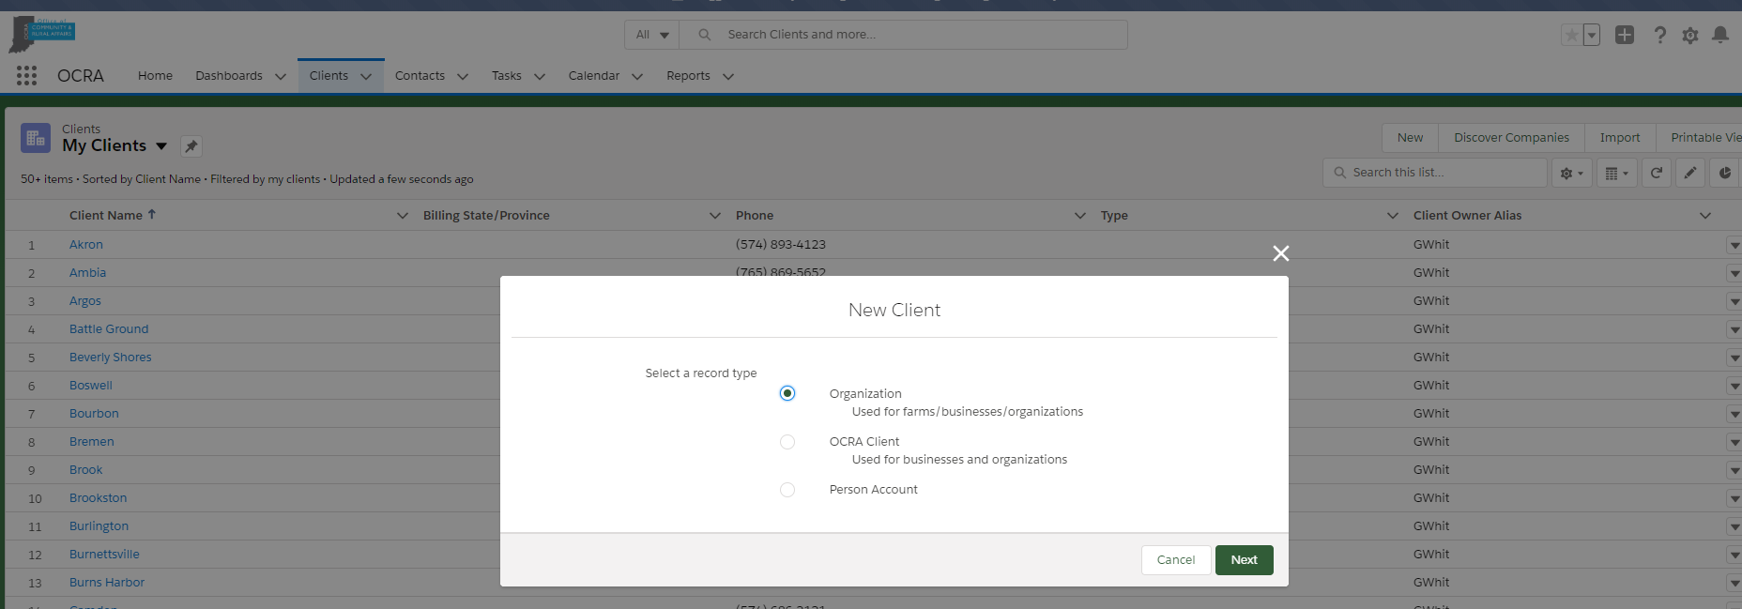
Client tab con’t
To create a new Client record click on the New button and a pop up window will appear. The record type will
default to Organization. It’s recommended to select OCRA Client.

Slide 18
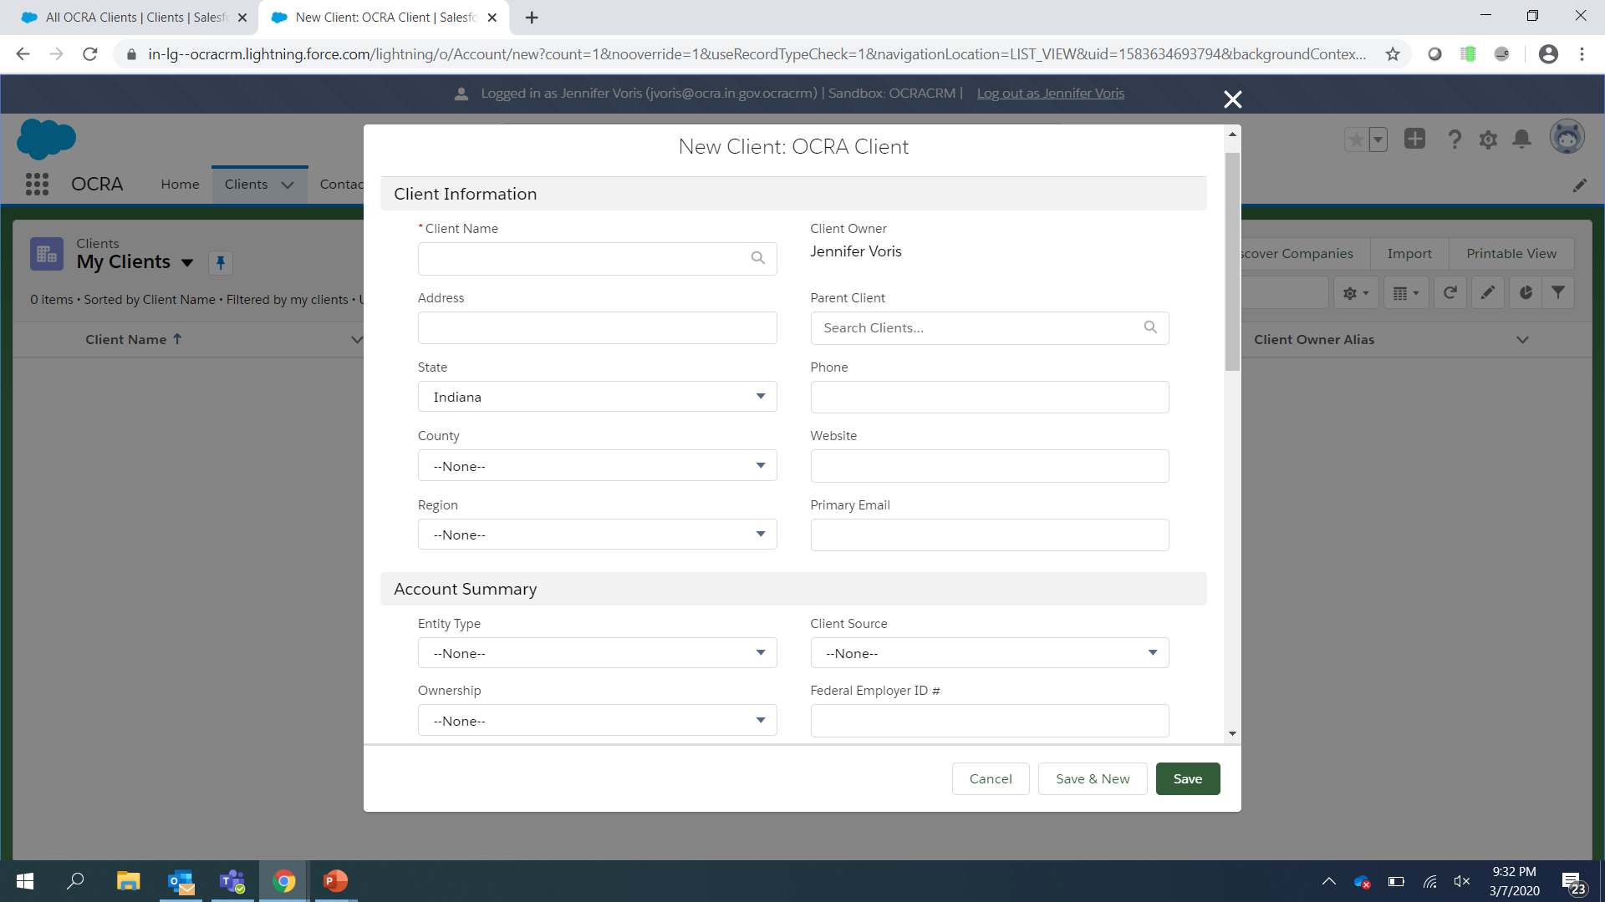
Client tab con’t
A red astrick indicates a required field. The magnifying glass indicates the field is a look up and will search Salesforce for an existing record, saving you time, effort and reducing duplicates.

Slide 19
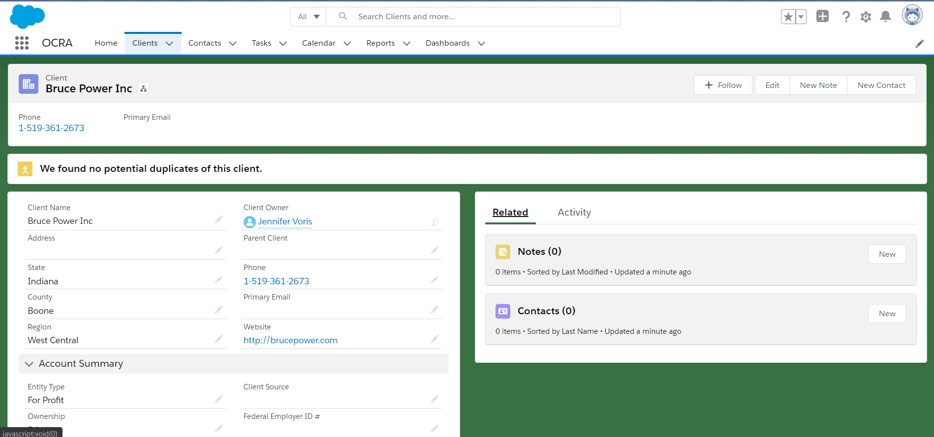
Client tab con’t
Once a Client record has been created you can create related Contact(s), Notes, Tasks and Events all from the same screen.

Slide 20
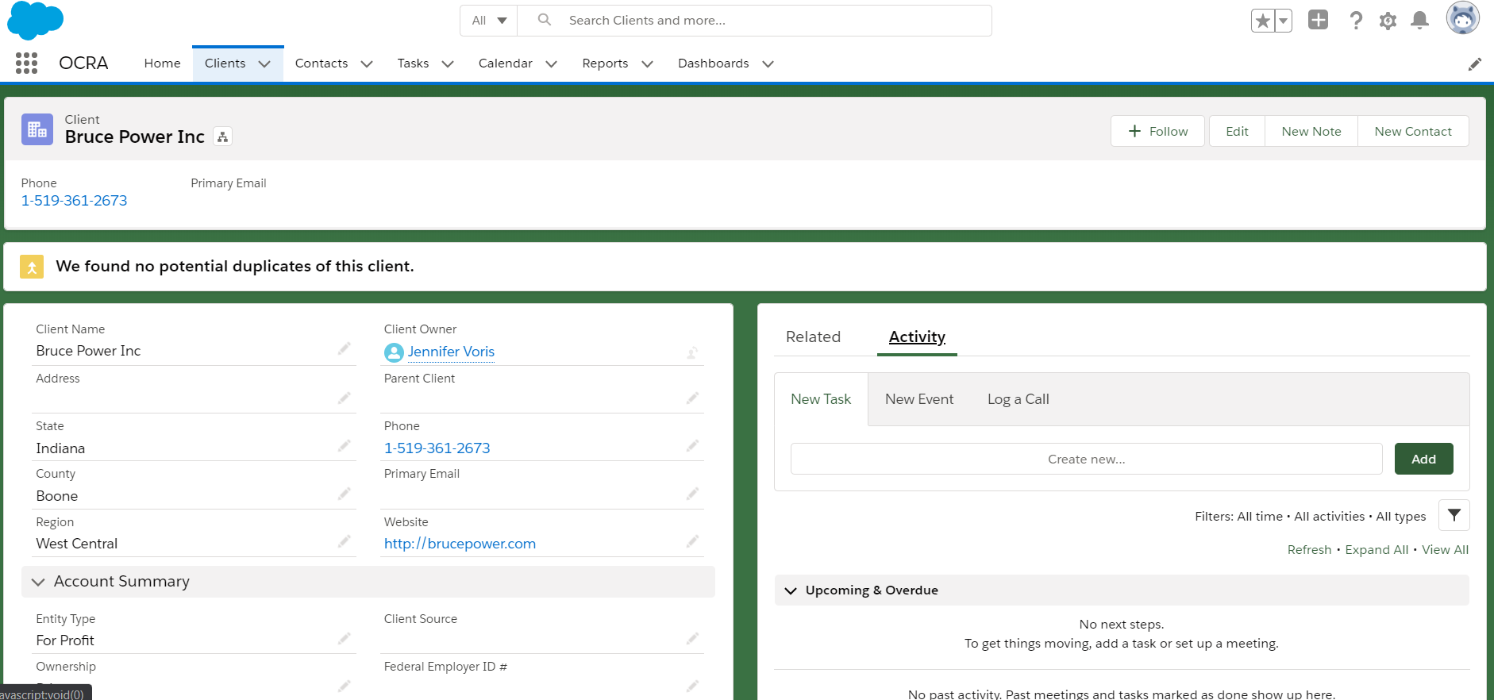
Client tab con’t
When creating a New Note, Contact, Task, Event or Log a Call the record will be automatically related to the Client record. In the example below, any new Task, Event or Log a Call will be related to Bruce Power, Inc.

Slide 21
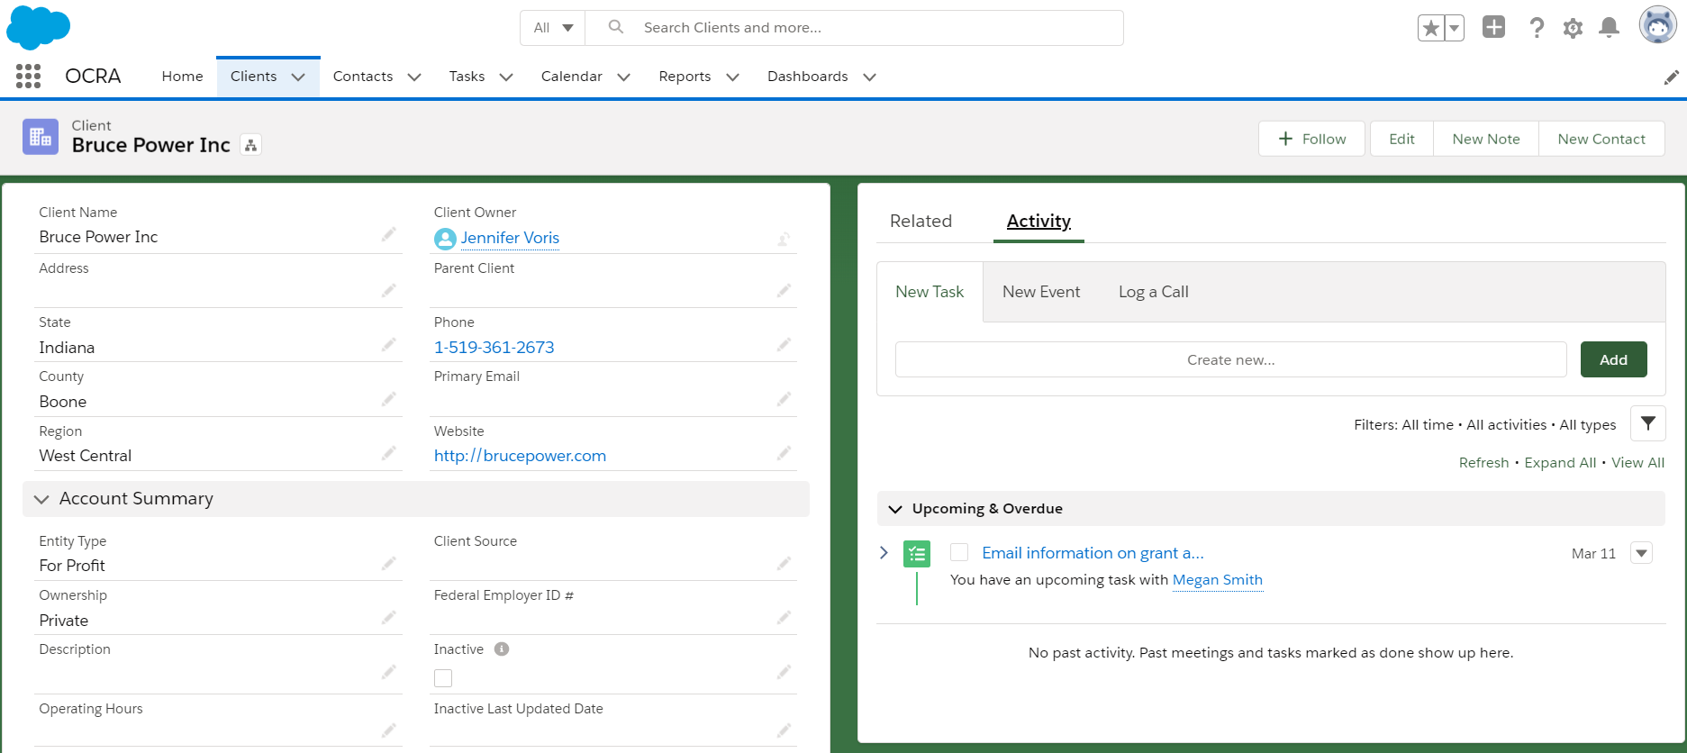
Client tab con’t
When a New Task, Event or Log a Call record is created it appears in the Upcoming & Overdue related list. Records are sorted by most recent upcoming date of activity. Clicking on a hyperlink will navigate you to the record’s details in a separate tab.

Slide 22
Contacts tab
Contacts can be created independent of Clients. From the Contacts tab select New button to create a new contact.

Slide 23
Contacts tab con’t
Select OCRA Contact and Next. In the next pop up window populate the fields. Users will also have the opportunity
to relate the new Contact to an existing Client by populating Client Name. Additional Contacts may be created by
Selecting Save & New.

Slide 24
Contacts tab con’t
When a New Task, Event or Log a Call record is created it appears in the Upcoming & Overdue related list. Records are sorted by most recent upcoming date of activity. Clicking on a hyperlink will navigate you to the record’s details in a separate tab.

Slide 25
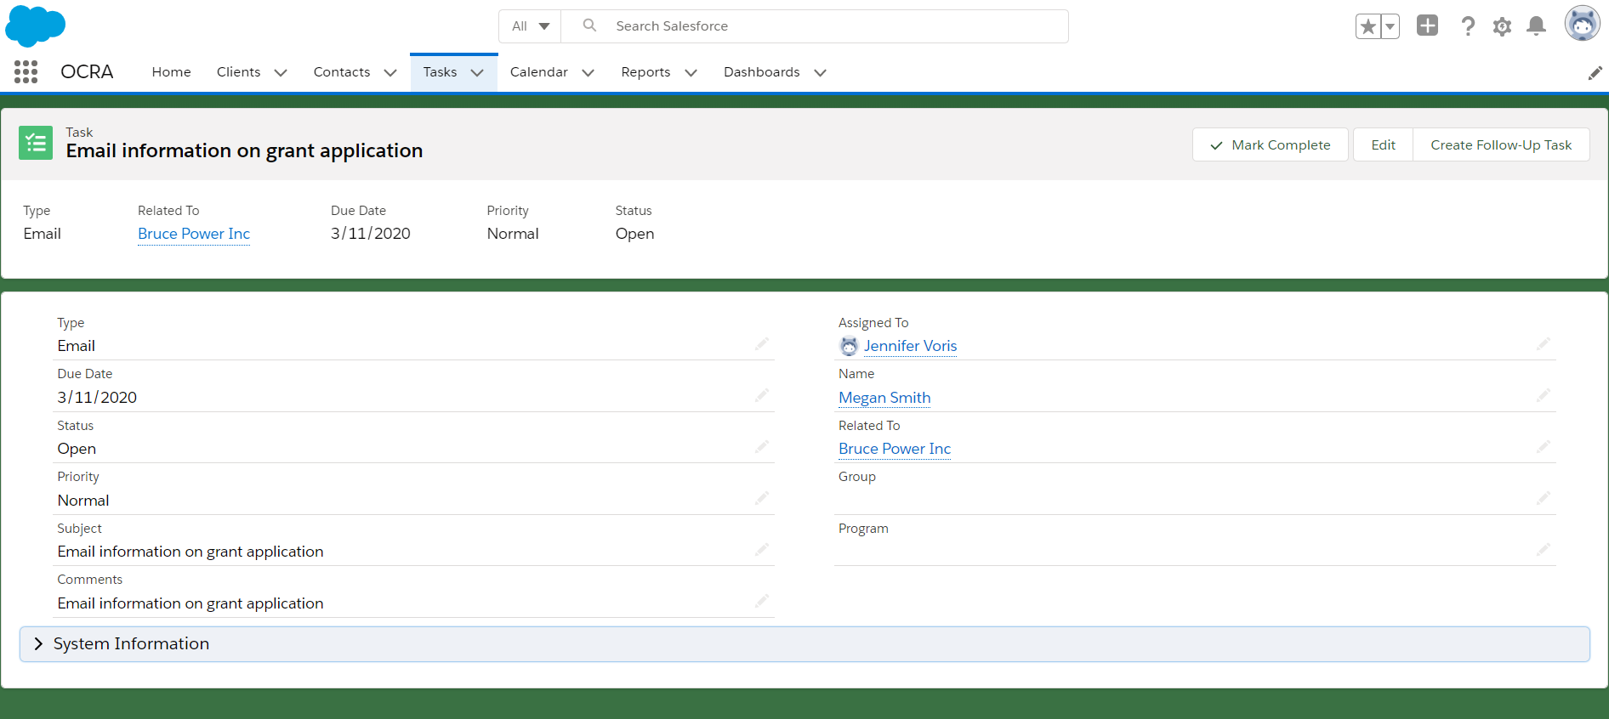
Tasks tab
Clicking on the Task hyperlink navigates you to the Tasks tab and the Details of the specified record. From the record you can Create Follow Up Task.

Slide 26
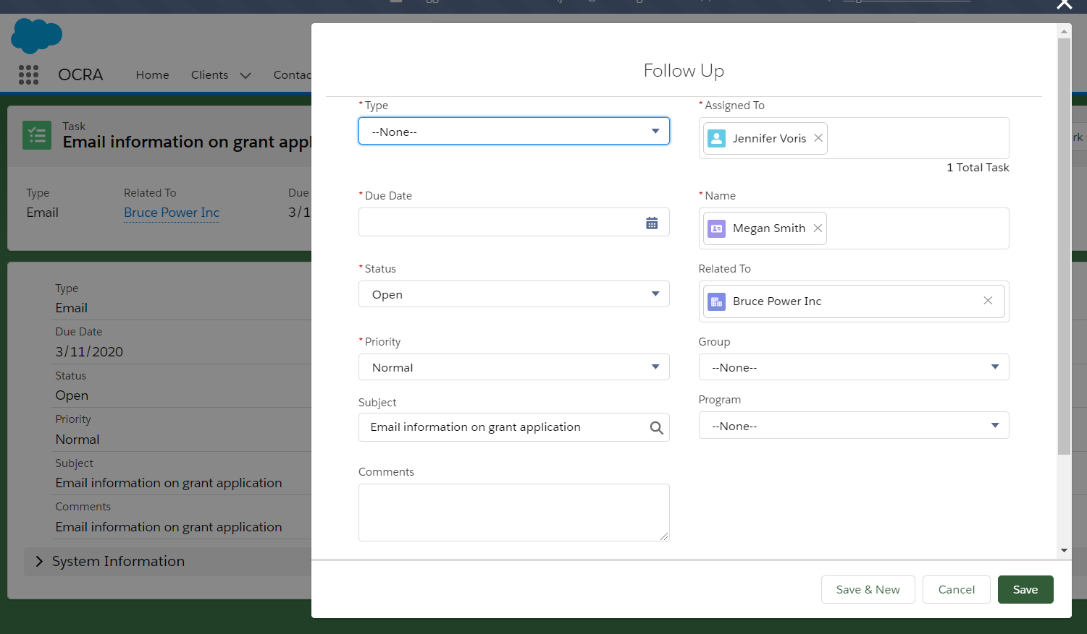
Task tab con’t
It’s important to note that Create Follow Up Task will clone some details of the original record. It is
recommended that the Subject line be updated from the original.

Slide 27
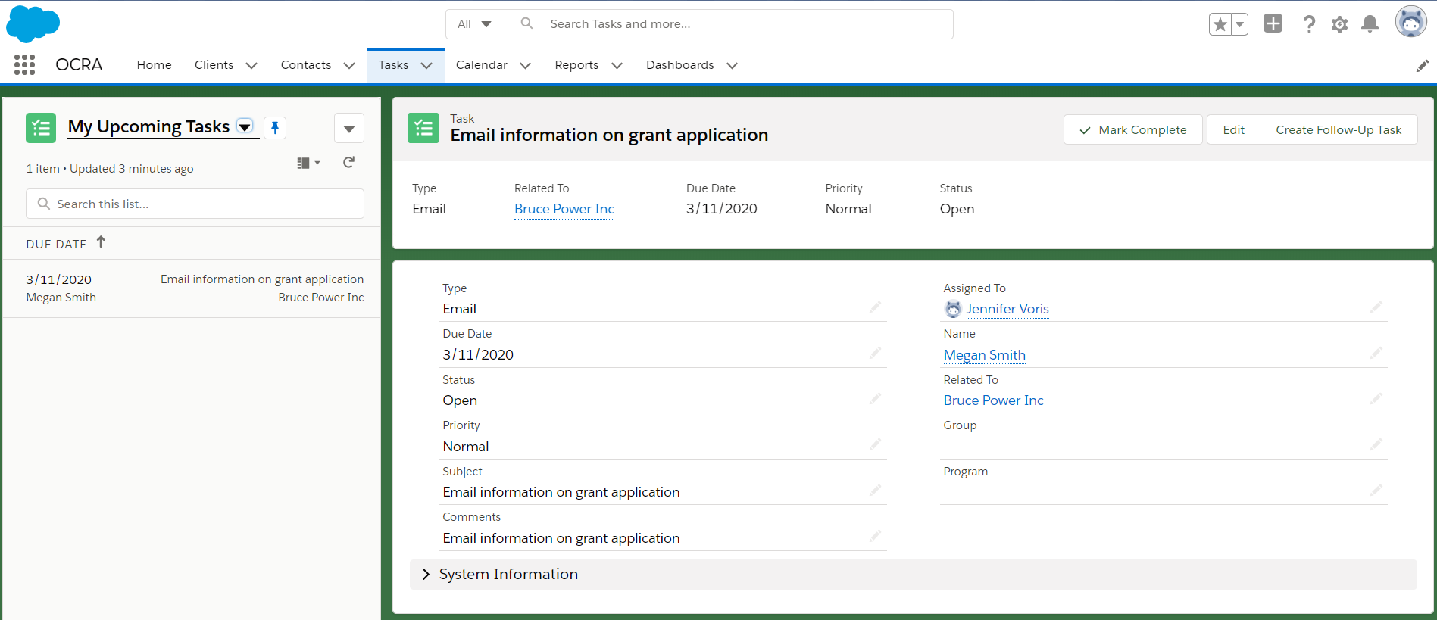
Task tab con’t
Clicking on Tasks will open a side panel, giving you options of which list view has been pinned or default to Recently Viewed. A New Task can be created by clicking on the inverted triangle.

Slide 28
Task tab con’t
Select OCRA Tasks. Users can relate a Task to multiple Contacts by selecting each Contact individually from
the Name field. A Task record will be created and related to each Contact. Each task would be completed independent of the other Tasks. The task will appear under Upcoming & Overdue section of the Contact record.

Slide 29
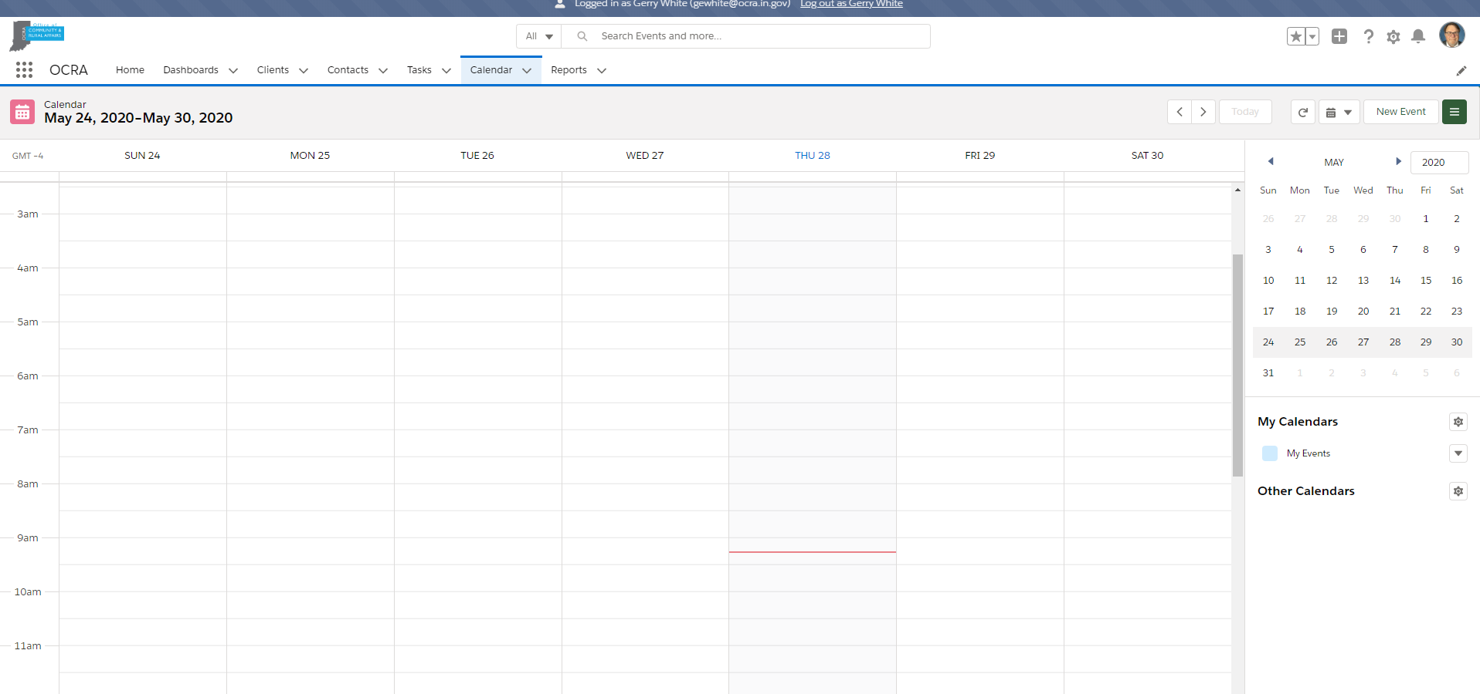
Calendar tab
To create an Event (meeting) that can be related to multiple Clients or Contacts, start from the Calendar tab instead of the individual Client or Contact record

Slide 30
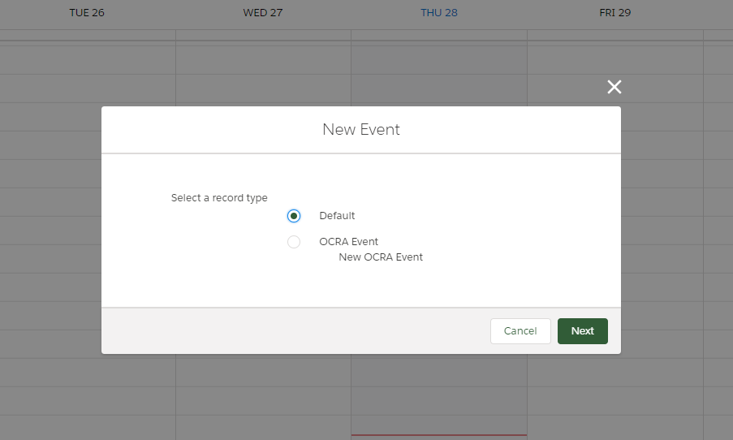
Calendar con’t
After clicking on New Event, a pop up will appear. It is recommended that OCRA Event is selected.

Slide 31
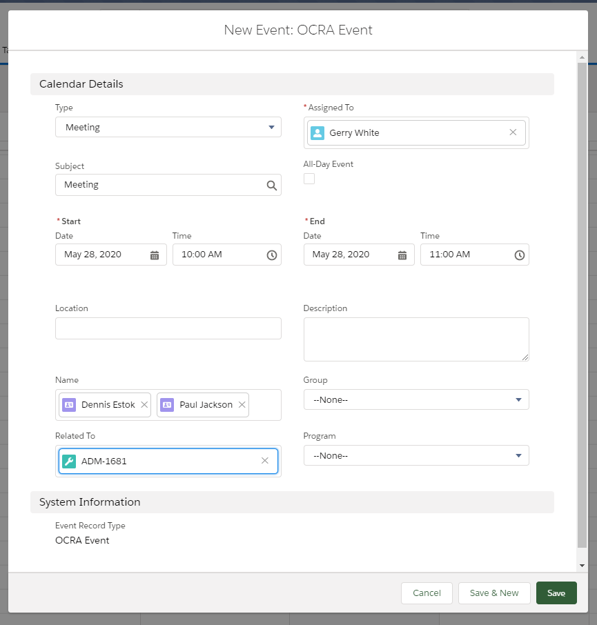
Calendar con’t
After selecting OCRA as the Event record type another pop up window will appear. Notice in the Name field are name for Contacts and may be populated with multiple Contacts. There is also the Related To. This is limited to 1 record. In the example below the related record is a specific Grant Application.

Slide 32
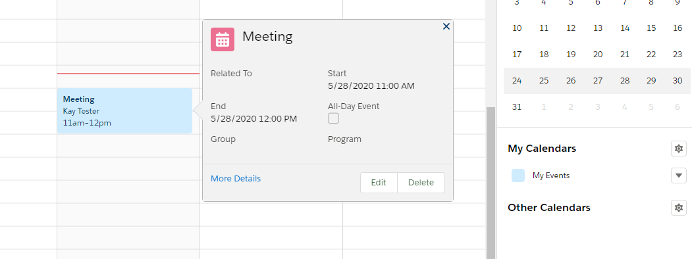
Calendar con’t
After selecting Save the meeting will be added to your calendar. Hovering over the meeting will provide basic details. The meeting will also appear on the Contact record under Upcoming & Overdue.

Slide 33
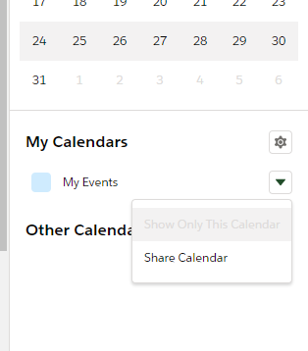
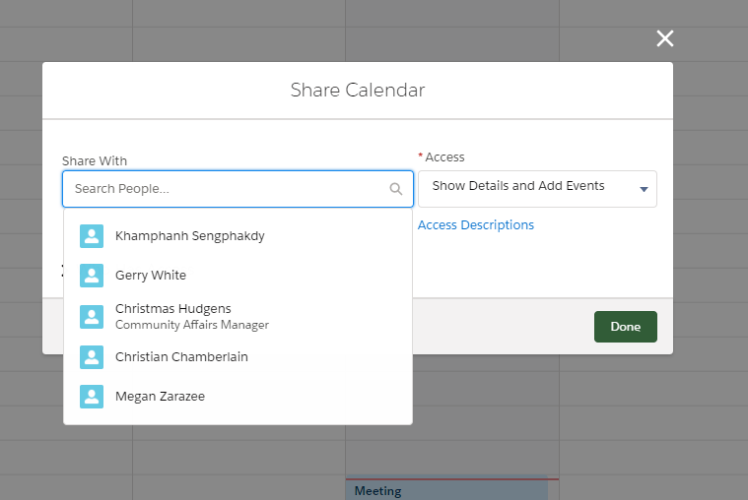
Calendar con’t
Share your calendar with others by clicking on the inverted triangle next to My Events. A pop up window will appear where other users may be added. Individuals will also be able to control the level of access others have under the Access field.

Slide 34
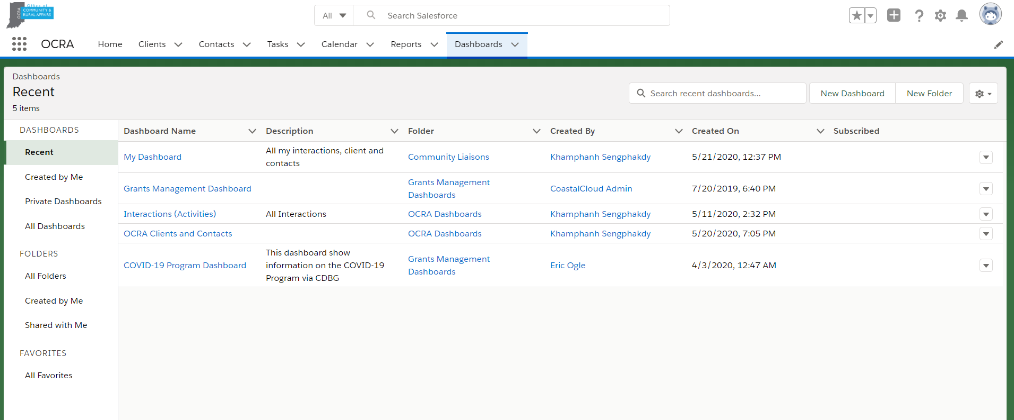
Reports and Dashboard
From the Dashboards tab easily access the My Dashboard. This dashboard was created to display a running user’s Clients, Contacts and Activities all in area.
Use the Search bar and type in My Dashboard if it is not immediately available.

Slide 35
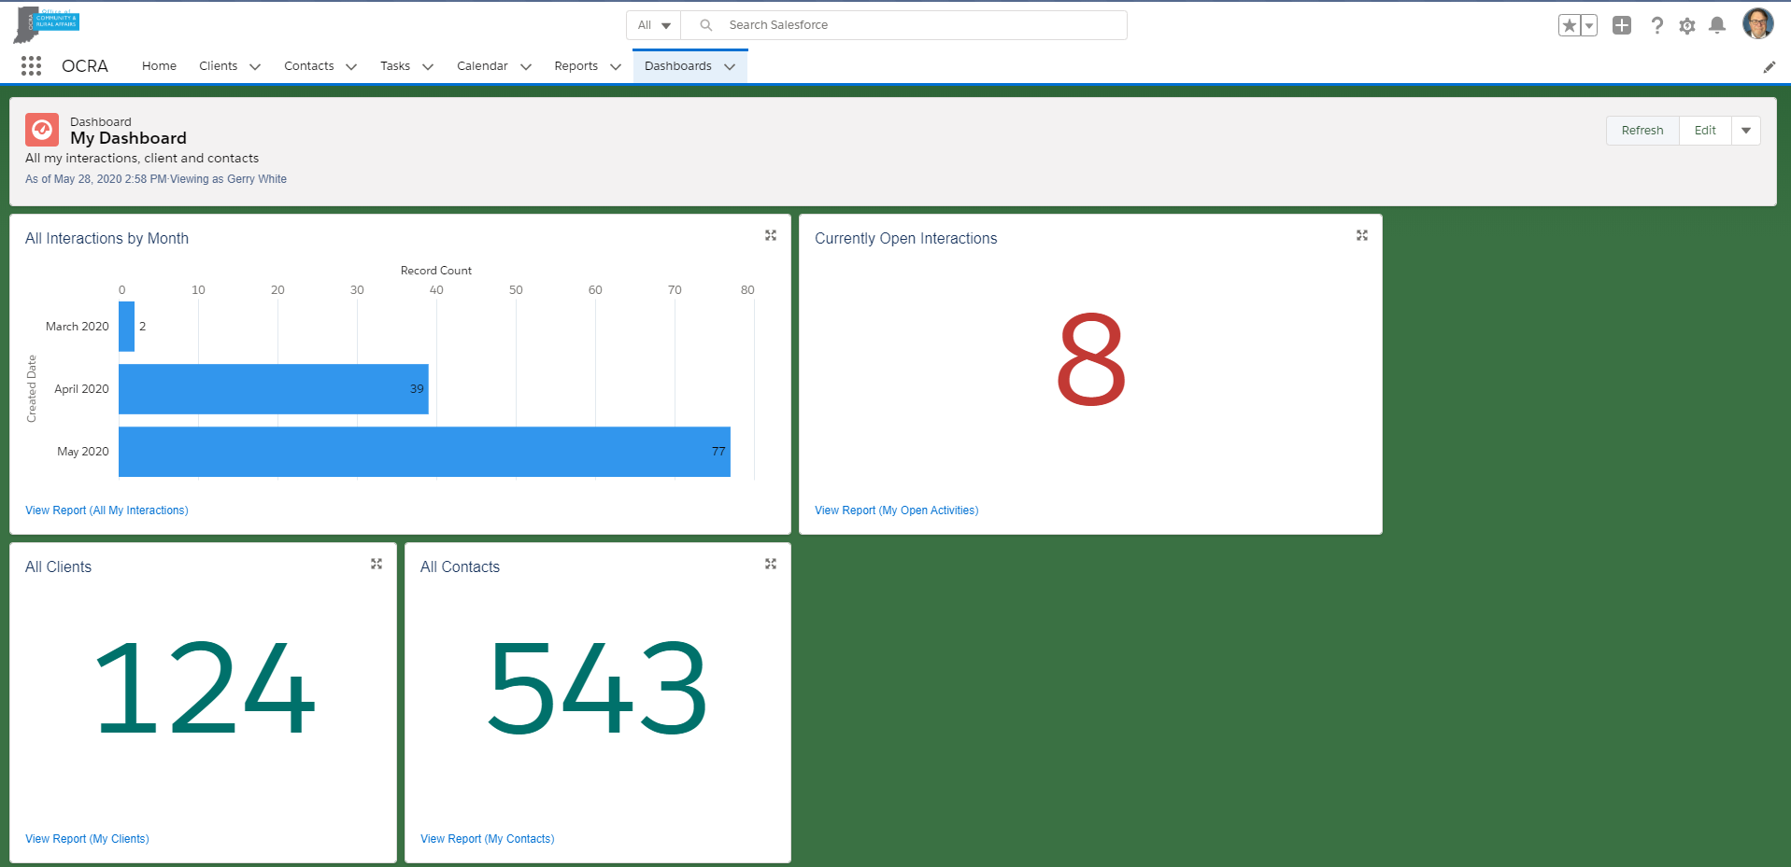
Reports and Dashboards con’t
It’s important to note the last time a dashboard was viewed. If more than a minute has lapsed, click the Refresh button.
Selecting the View Report within each component of the dashboard will navigate the user to that specific report.

Slide 36
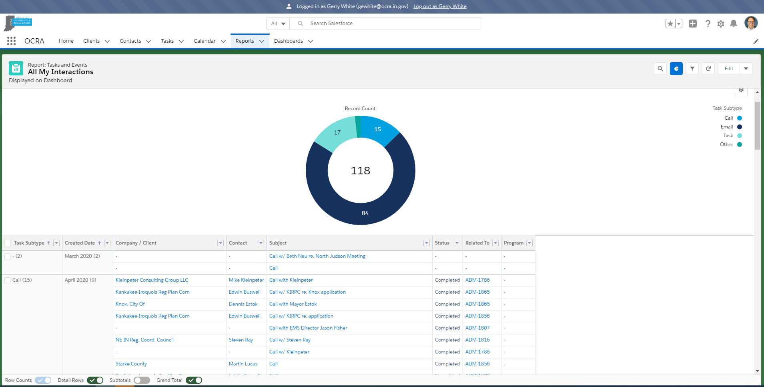
Reports and Dashboard con’t
In the example below is the report linked to the All Interactions by Month component from the My Dashboard.
The report will offer more details.

Slide 37
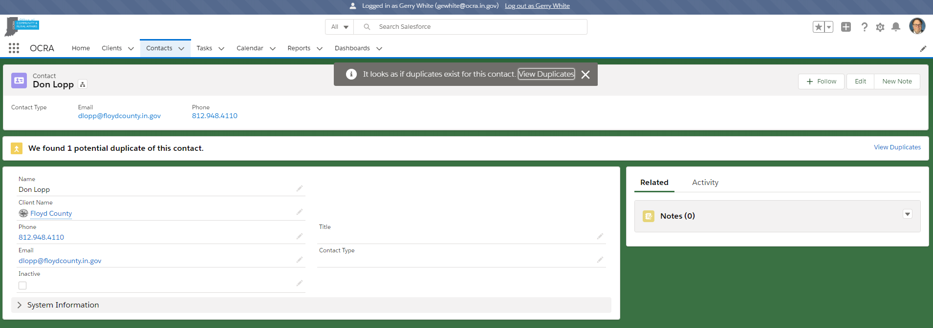
Common Tools – Merging Duplicate Client & Contact records
When a duplicate of a Client or Contact record is found a message will appear. Click on View Duplicates to begin
the process to merge the records.
*Note users will only be able to merge duplicates they own. If a duplicate is owned by another user there will be a
message to contact the Salesforce admin for assistance to merge the records.

Slide 38
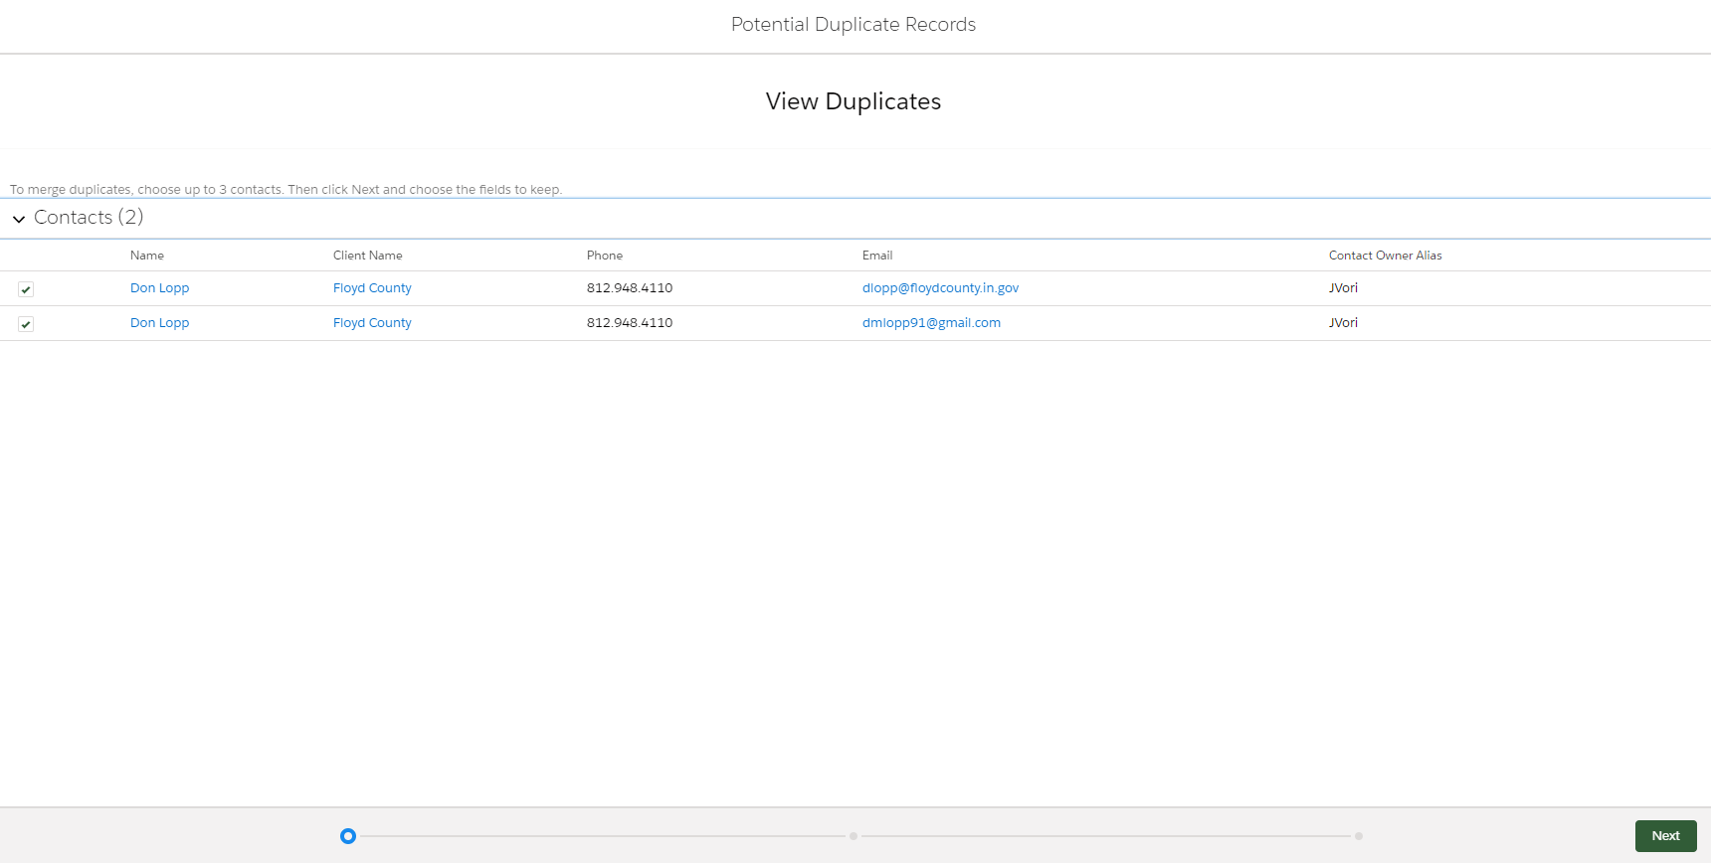
Common Tools – Merging Duplicate Client & Contact records
Select the duplicate records to merge and select Next.

Slide 39
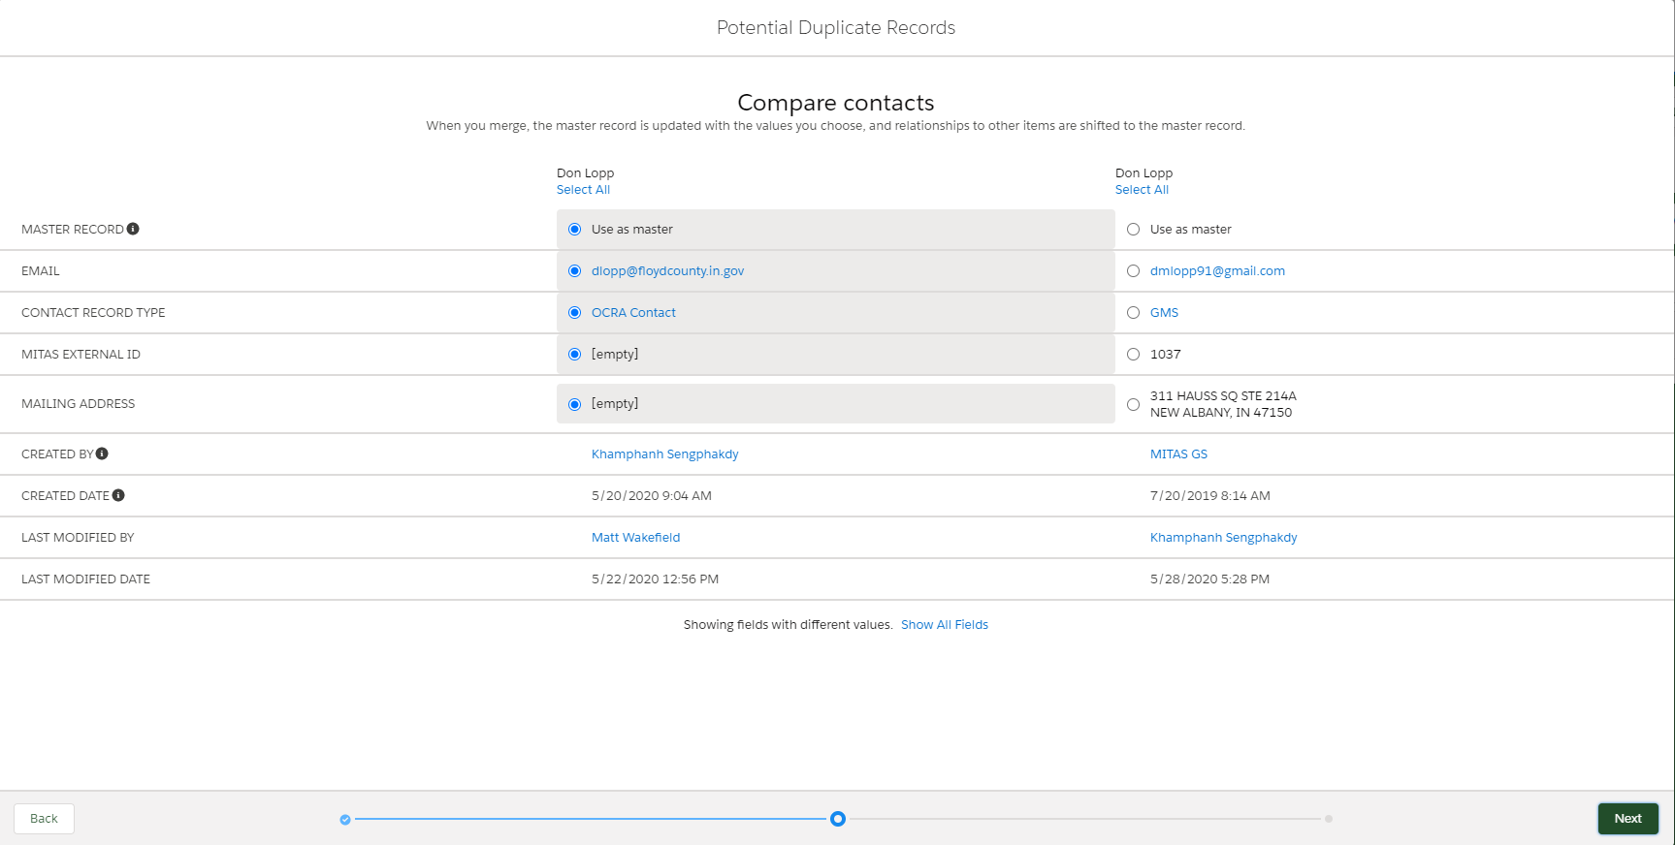
Common Tools – Merging Duplicate Client & Contact records
Select the details from each record that should be retained and select Next.

Slide 40
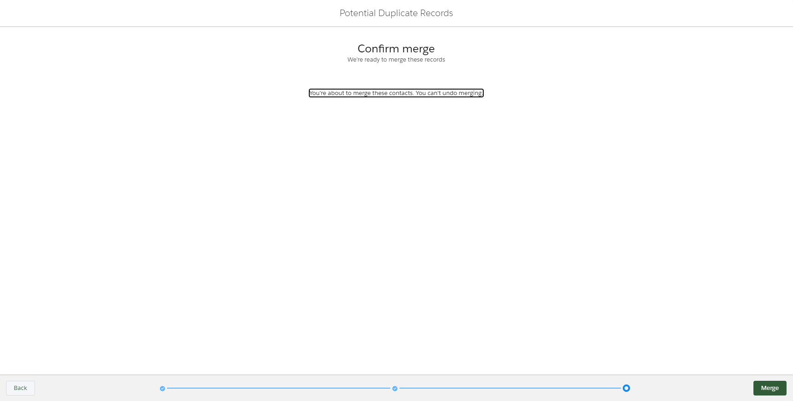
Common Tools – Merging Duplicate Client & Contact records
The final confirmation screen is the last opportunity to back out of merging records. Merging of records cannot be undone.

Slide 41
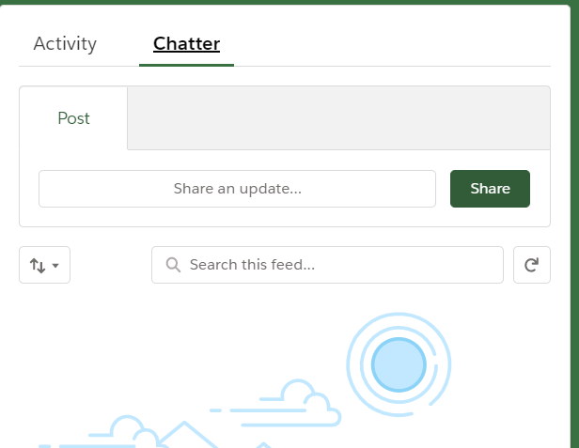
Common Tools – Chatter
Chatter can be used for collaboration with any active Salesforce user. Use the @mention (users name) very much like social media. The person receiving the message will receive an email as well as a notification within Salesforce. A red dot with a number in the center will appear on the bell icon in the upper righthand corner of all screens as a visual notification.

